Slide 1
The Digital Transformation Agenda
Impact on software developers – discussion forum

Slide 2
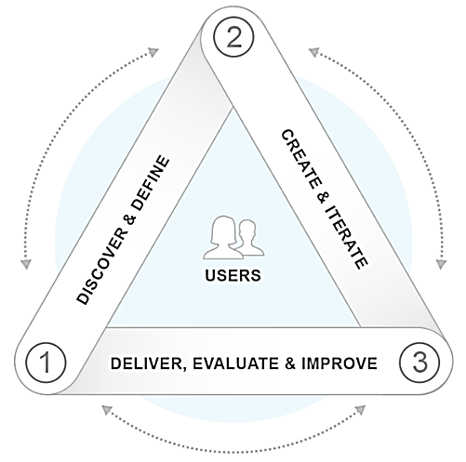
Layers of Digital Transformation
Standards and frameworks
Platforms
Digital capabilities

Slide 3
Digital Service Standard
Developed as a result of Government Policy
Puts users at the centre of service delivery
Common elements and tools gives efficiency
Leverages technological advances and flexibility
16 criteria to guide service delivery development
www.dto.gov.au/standard

Slide 4
Support for development teams
‘How to guidance’ being prepared
Initial guidance published
Digital Service Design Guide coming
Code and other repositories being considered
E.g. Canadian ‘web experience toolkit’

Slide 5
The Trusted Digital Identity Framework
Will establish the over-arching governance structure for a federated digital identity system and will comprise:
the Technical and Operational Specifications
the Legal Rules that govern the identity system
Will be underpinned by open standards (eg OpenID Connect etc)
what issues do you think need to be addressed when developing the framework?

Slide 6
The information layer
Experimenting with setting up a “discovery layer”
Supporting mashable government
Building a whole of government service analytics capability
Will be publishing code, standards and prototypes

Slide 7
The digital capabilities
High level design is underway for capabilities across business account including digital mail, tell us once, authorised representative and linking an ABN to myGov.
Consideration of both retail and wholesale solutions.

Slide 8
iDTO Co-design with individuals, sole traders and small business
What we’ve done
Partnered with ATO and DHS to undertake co-design activities with individuals, sole-traders and small businesses
Developed interactive prototypes
What we’re planning
Further co-design with individuals, sole traders and small businesses in May 2015
Completion of 3rd iteration of prototype, incorporating all prior co-design findings
Future engagement with medium business, large business and third party providers
What we’ve found
Users value security, convenience, transparency and control
Services should be simple and easy to use
Need clear value proposition for each offering
Want ‘choice’ but it can not be complex
Current business software users prefer to access the business account features via their software.
However, many business users would prefer to use a retail offering

Slide 9
For discussion
Your feedback on the DTO approach to date.
What are your priority issues relating to the Digital Transformation agenda?
How will you engage with the agenda?

Slide 10
Contacts
David Hazlehurst
A/g CEO p: (02) 6228 6725
e: david.hazlehurst@pmc.gov.au
Robert Ravanello
Head of Design
p: (02) 6228 6721
e: robert.ravanello@pmc.gov.au
Kim Terrell
Head of Strategy
p: (02) 6228 6880
e: kim.terrell@pmc.gov.au
@AusDTO
www.dto.gov.au/engage
www.dto.gov.au

