Slide 1
The Digital Transformation Agenda
May 2015

Slide 2
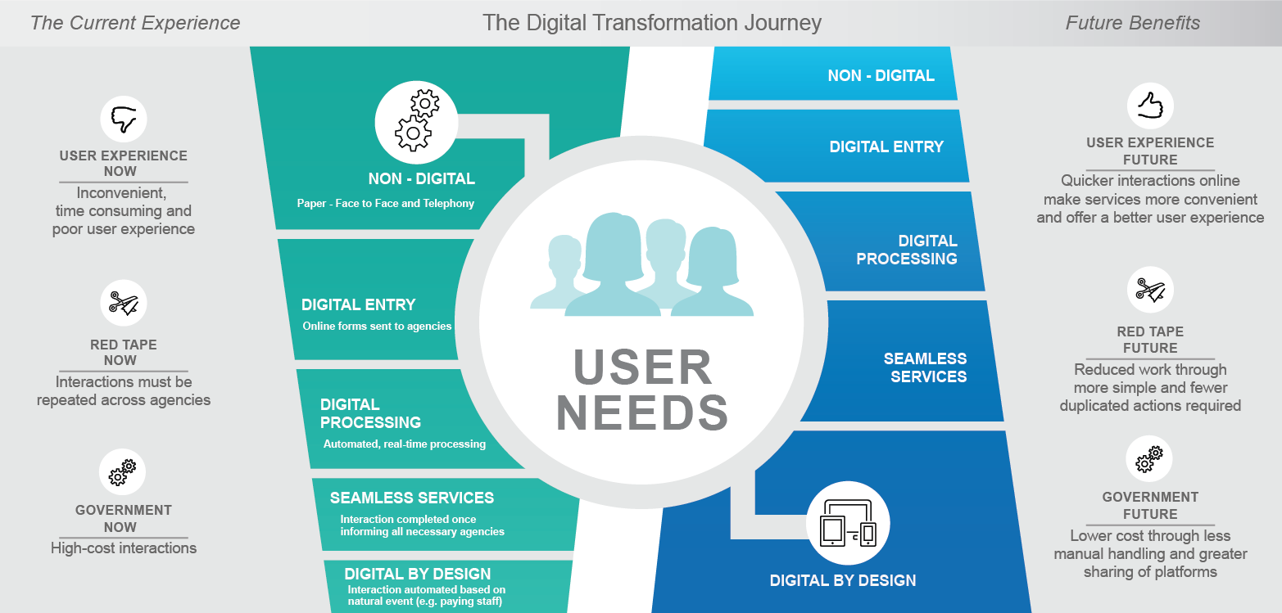
The challenge

Slide 3
The case for change

Slide 4
The five key elements of the Agenda
Connect people with services
Make it easier for business
Better outcomes for users
Efficiencies for government
Red tape reductions for individuals and businesses
Improve access to information
Transform face-to-face and telephony services
Strong leadership across government

Slide 5
1. Connect people with services
More myGov services
Trusted digital identities
Better ‘Tell Us Once’ services
Whole-of-government digital mail

Slide 6
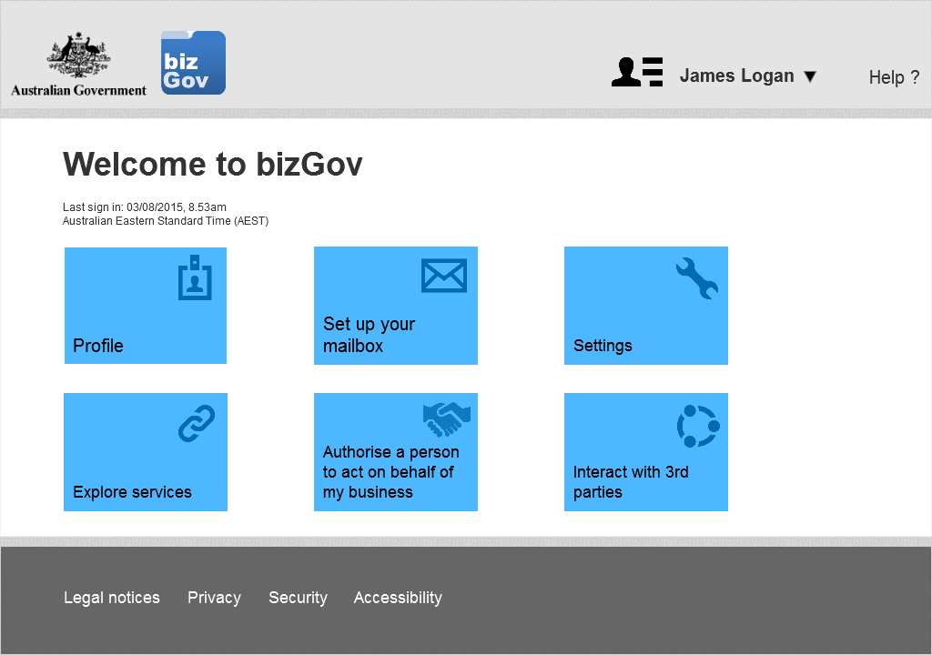
2. Make it easier for business
A new business account
Making business easier
Streamlined grants administration

Slide 7
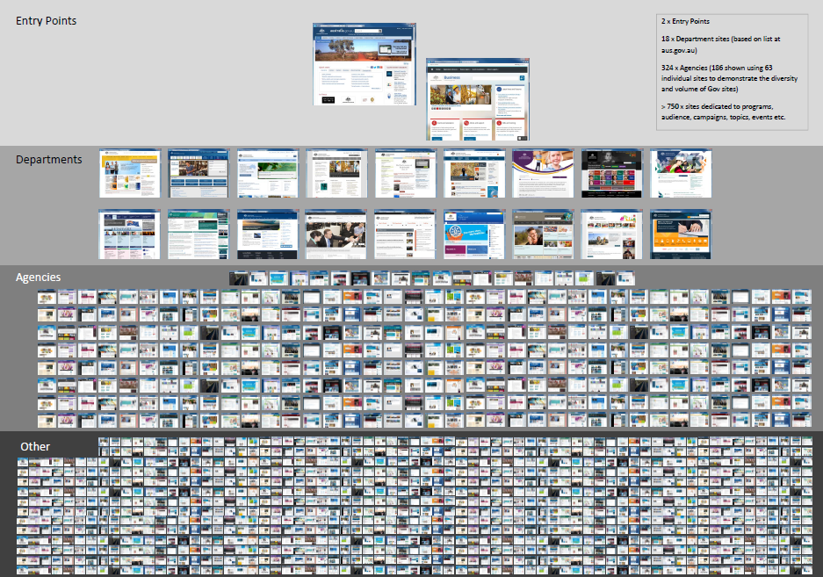
3. Improve access to information

Slide 8
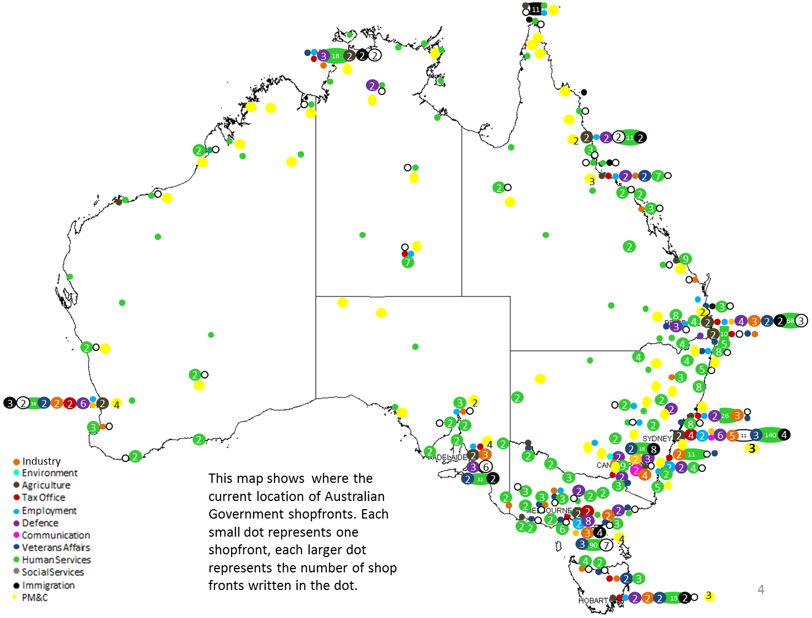
4. Transform face-to-face and telephony services
Integrated whole-of-government face-to-face and telephony services
Map showing current locations of government shopfronts

Slide 9
5. Strong leadership across government
A new whole-of-government approach
A new Digital Service Standard
www.dto.gov.au/standard

Slide 10
Next steps

Slide 11
Contacts
David Hazlehurst
A/g CEO p: (02) 6228 6725
e: david.hazlehurst@pmc.gov.au
Robert Ravanello
Head of Design
p: (02) 6228 6721
e: robert.ravanello@pmc.gov.au
Kim Terrell
Head of Strategy
p: (02) 6228 6880
e: kim.terrell@pmc.gov.au
@AusDTO
www.dto.gov.au/engage
www.dto.gov.au

